Slide 1
UNIT-II Fundamental Duties
Dr.P.DEVI

Slide 2


Slide 3
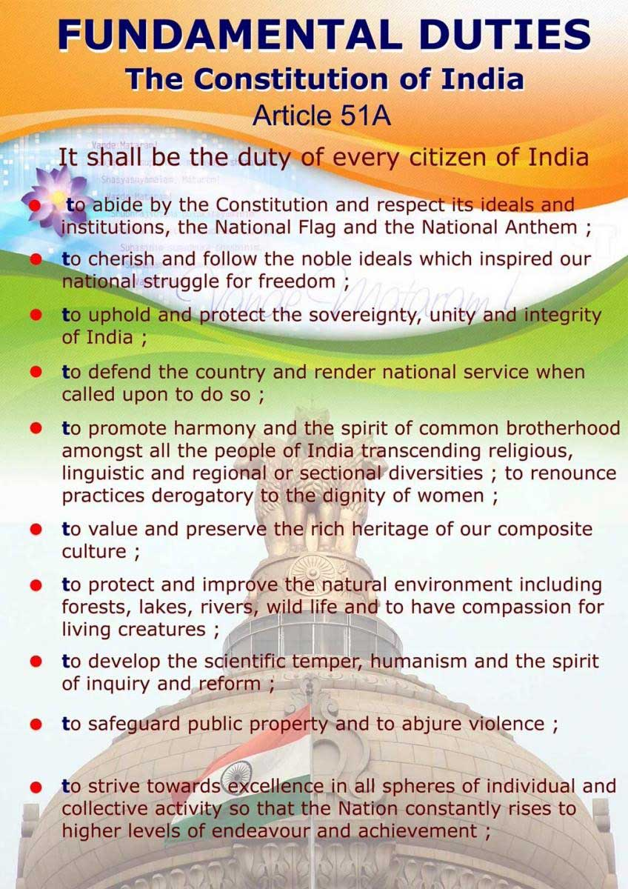
Unit-II Fundamental Duties
Dr.P.DEVI

Slide 4
Fundamental Duties
Fundamental duties are defined as moral obligations of all citizens to help promote a spirit of patriotism and to uphold the unity of India.
Originally, the constitution of India did not contain any list of fundamental duties. In other words, enjoyment of fundamental rights was not conditional on the performance of fundamental duties.

Slide 5
Fundamental Duties
The Fundamental Duties of Indian Citizens were added as Article 51-A by the 42nd Amendment, 1976.
These are non-justifiable i.e. their compliance cannot be enforced by law, but serves as moral responsibility on the citizens.
Originally 10 Fundamental Duties, 11th Fundamental Duty was added by 86th Amendment in 2002. At Present we have 11 Fundamental Duties.

Slide 6
Fundamental Duties
Fundamental rights and Fundamental duties are correlated. Either of them cannot be ignored. Art. 51A, Part IVA of the Indian Constitution, specifies the list of fundamental duties of the citizens. It says “it shall be the duty of every citizen of India:

Slide 7
Fundamental Duties
(a) To abide by the Constitution and respect its ideals and institutions, the National Flag and the National Anthem;
(b) To cherish and follow the noble ideals which inspired our national struggle for freedom;
(c) To uphold and protect the sovereignty, unity and integrity of India;
(d) To defend the country and render national service when called upon to do so;

Slide 8
Fundamental Duties
(e) To promote harmony and the spirit of common brotherhood amongst all the people of India transcending religious, linguistic and regional or sectional diversities; to renounce practices derogatory to the dignity of women;
(f) To value and preserve the rich heritage of our composite culture;
(g) To protect and improve the natural environment including forests, lakes, rivers and wild life, and to have compassion for living creatures;

Slide 9
Fundamental Duties
(h) To develop the scientific temper, humanism and the spirit of inquiry and reform;
(i) To safeguard public property and to abjure violence;
(j) To strive towards excellence in all spheres of individual and collective activity so that the nation constantly rises to higher levels of endeavour and achievement.

Slide 10
Fundamental Duties
(k) It is the duty of every parent or guardian to ensure that their child or ward was provided opportunities for education between the ages of six and fourteen years. (added by 86th Amendment in 2002)

Slide 11


